Slide 1


Big Data Infrastructure
Session 5: MapReduce – Graphs
Jimmy Lin
University of Maryland
Monday, March 2, 2015
This work is licensed under a Creative Commons Attribution-Noncommercial-Share Alike 3.0 United States See http://creativecommons.org/licenses/by-nc-sa/3.0/us/ for details

Slide 2
Today’s Agenda
Graph problems and representations
Parallel breadth-first search
PageRank
Beyond PageRank and other graph algorithms
Optimizing graph algorithms

Slide 3
What’s a graph?
G = (V,E), where
V represents the set of vertices (nodes)
E represents the set of edges (links)
Both vertices and edges may contain additional information
Different types of graphs:
Directed vs. undirected edges
Presence or absence of cycles
Graphs are everywhere:
Hyperlink structure of the web
Physical structure of computers on the Internet
Interstate highway system
Social networks

Slide 4
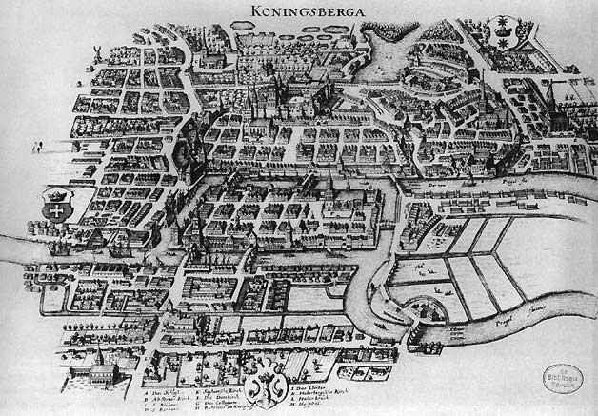
Source: Wikipedia (Königsberg)

Slide 5

Source: Wikipedia (Kaliningrad)

Slide 6
Some Graph Problems
Finding shortest paths
Routing Internet traffic and UPS trucks
Finding minimum spanning trees
Telco laying down fiber
Finding Max Flow
Airline scheduling
Identify “special” nodes and communities
Breaking up terrorist cells, spread of avian flu
Bipartite matching
Monster.com, Match.com
And of course... PageRank

Slide 7
Graphs and MapReduce
A large class of graph algorithms involve:
Performing computations at each node: based on node features, edge features, and local link structure
Propagating computations: “traversing” the graph
Key questions:
How do you represent graph data in MapReduce?
How do you traverse a graph in MapReduce?

Slide 8
Representing Graphs
G = (V, E)
Two common representations
Adjacency matrix
Adjacency list

Slide 9
Adjacency Matrices
Represent a graph as an n x n square matrix M
n = |V|
M_{ij} = 1 means a link from node i to j
2
 | 1 | 2 | 3 | 4
1 | 0 | 1 | 0 | 1
2 | 1 | 0 | 1 | 1
3 | 1 | 0 | 0 | 0
4 | 1 | 0 | 1 | 0
1
3
4

Slide 10
Adjacency Matrices: Critique
Advantages:
Amenable to mathematical manipulation
Iteration over rows and columns corresponds to computations on outlinks and inlinks
Disadvantages:
Lots of zeros for sparse matrices
Lots of wasted space

Slide 11
Adjacency Lists
Take adjacency matrices… and throw away all the zeros
 | 1 | 2 | 3 | 4
1 | 0 | 1 | 0 | 1
2 | 1 | 0 | 1 | 1
3 | 1 | 0 | 0 | 0
4 | 1 | 0 | 1 | 0
1: 2, 4
2: 1, 3, 4
3: 1
4: 1, 3

Slide 12
Adjacency Lists: Critique
Advantages:
Much more compact representation
Easy to compute over outlinks
Disadvantages:
Much more difficult to compute over inlinks

Slide 13
Single-Source Shortest Path
Problem: find shortest path from a source node to one or more target nodes
Shortest might also mean lowest weight or cost
First, a refresher: Dijkstra’s Algorithm

Slide 14
Dijkstra’s Algorithm Example
∞
1
∞
10
0
2
3
9
4
6
5
7
∞
∞
2
Example from CLR

Slide 15
Dijkstra’s Algorithm Example
10
1
∞
10
0
2
3
9
4
6
5
7
5
∞
2
Example from CLR

Slide 16
Dijkstra’s Algorithm Example
8
1
14
10
0
2
3
9
4
6
5
7
5
7
2
Example from CLR

Slide 17
Dijkstra’s Algorithm Example
8
1
13
10
0
2
3
9
4
6
5
7
5
7
2
Example from CLR

Slide 18
Dijkstra’s Algorithm Example
8
1
9
1
10
0
2
3
9
4
6
5
7
5
7
2
Example from CLR

Slide 19
Dijkstra’s Algorithm Example
8
1
9
10
0
2
3
9
4
6
5
7
5
7
2
Example from CLR

Slide 20
Single-Source Shortest Path
Problem: find shortest path from a source node to one or more target nodes
Shortest might also mean lowest weight or cost
Single processor machine: Dijkstra’s Algorithm
MapReduce: parallel breadth-first search (BFS)

Slide 21
Finding the Shortest Path
Consider simple case of equal edge weights
Solution to the problem can be defined inductively
Here’s the intuition:
Define: b is reachable from a if b is on adjacency list of a
DistanceTo(s) = 0
For all nodes p reachable from s, DistanceTo(p) = 1
For all nodes n reachable from some other set of nodes M, DistanceTo(n) = 1 + min(DistanceTo(m), m ∈ M)
d₁
m₁
…
d₂
s
…
n
m₂
…
d₃
m₃

Slide 22

Source: Wikipedia (Wave)

Slide 23
Visualizing Parallel BFS
n₇
n₀
n₁
n₃
n₂
n₆
n₅
n₄
n₈
n₉

Slide 24
From Intuition to Algorithm
Data representation:
Key: node n
Value: d (distance from start), adjacency list (nodes reachable from n)
Initialization: for all nodes except for start node, d = ∞
Mapper:
∀m ∈ adjacency list: emit (m, d + 1)
Remember to also emit distance to yourself
Sort/Shuffle
Groups distances by reachable nodes
Reducer:
Selects minimum distance path for each reachable node
Additional bookkeeping needed to keep track of actual path

Slide 25
Multiple Iterations Needed
Each MapReduce iteration advances the “frontier” by one hop
Subsequent iterations include more and more reachable nodes as frontier expands
Multiple iterations are needed to explore entire graph
Preserving graph structure:
Problem: Where did the adjacency list go?
Solution: mapper emits (n, adjacency list) as well

Slide 26
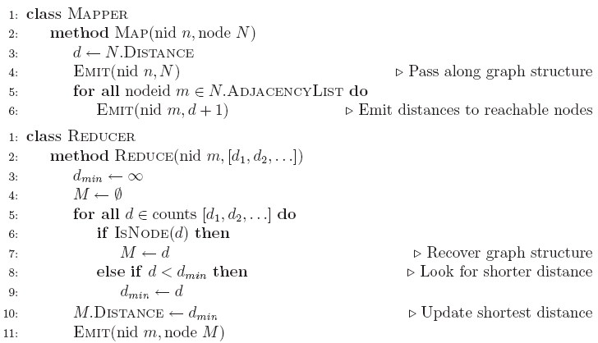
BFS Pseudo-Code

Slide 27
Stopping Criterion
How many iterations are needed in parallel BFS (equal edge weight case)?
Convince yourself: when a node is first “discovered”, we’ve found the shortest path
Now answer the question...
Six degrees of separation?
Practicalities of implementation in MapReduce

Slide 28
Comparison to Dijkstra
Dijkstra’s algorithm is more efficient
At each step, only pursues edges from minimum-cost path inside frontier
MapReduce explores all paths in parallel
Lots of “waste”
Useful work is only done at the “frontier”
Why can’t we do better using MapReduce?

Slide 29
Single Source: Weighted Edges
Now add positive weights to the edges
Why can’t edge weights be negative?
Simple change: add weight w for each edge in adjacency list
In mapper, emit (m, d + w_{p}) instead of (m, d + 1) for each node m
That’s it?

Slide 30
Stopping Criterion
How many iterations are needed in parallel BFS (positive edge weight case)?
Convince yourself: when a node is first “discovered”, we’ve found the shortest path
Not true!

Slide 31
Additional Complexities
search frontier
1
n₆
1
n₇
1
n₈
r
10
1
n₅
n₉
n₁
s
1
1
p
q
n₄
1
n₂
1
n₃

Slide 32
Stopping Criterion
How many iterations are needed in parallel BFS (positive edge weight case)?
Practicalities of implementation in MapReduce

Slide 33

Application: Social Search
Source: Wikipedia (Crowd)

Slide 34
Social Search
When searching, how to rank friends named “John”?
Assume undirected graphs
Rank matches by distance to user
Naïve implementations:
Precompute all-pairs distances
Compute distances at query time
Can we do better?

Slide 35
All-Pairs?
Floyd-Warshall Algorithm: difficult to MapReduce-ify…
Multiple-source shortest paths in MapReduce: run multiple parallel BFS simultaneously
Assume source nodes {s₀, s₁, … s_{n}}
Instead of emitting a single distance, emit an array of distances, with respect to each source
Reducer selects minimum for each element in array
Does this scale?

Slide 36
Landmark Approach (aka sketches)
Select n seeds {s₀, s₁, … s_{n}}
Compute distances from seeds to every node:
What can we conclude about distances?
Insight: landmarks bound the maximum path length
Lots of details:
How to more tightly bound distances
How to select landmarks (random isn’t the best…)
Use multi-source parallel BFS implementation in MapReduce!
A = [2, 1, 1]
B = [1, 1, 2]
C = [4, 3, 1]
D = [1, 2, 4]

Slide 37
<pause/>
Source: Wikipedia (Wave)

Slide 38
Graphs and MapReduce
A large class of graph algorithms involve:
Performing computations at each node: based on node features, edge features, and local link structure
Propagating computations: “traversing” the graph
Generic recipe:
Represent graphs as adjacency lists
Perform local computations in mapper
Pass along partial results via outlinks, keyed by destination node
Perform aggregation in reducer on inlinks to a node
Iterate until convergence: controlled by external “driver”
Don’t forget to pass the graph structure between iterations

Slide 39
Random Walks Over the Web
Random surfer model:
User starts at a random Web page
User randomly clicks on links, surfing from page to page
PageRank
Characterizes the amount of time spent on any given page
Mathematically, a probability distribution over pages
PageRank captures notions of page importance
Correspondence to human intuition?
One of thousands of features used in web search (query-independent)

Slide 40
PageRank: Defined
Given page x with inlinks t₁…t_{n}, where
C(t) is the out-degree of t
α is probability of random jump
N is the total number of nodes in the graph
t₁
X
t₂
…
t_{n}

Slide 41
Computing PageRank
Properties of PageRank
Can be computed iteratively
Effects at each iteration are local
Sketch of algorithm:
Start with seed PR_{i} values
Each page distributes PR_{i} “credit” to all pages it links to
Each target page adds up “credit” from multiple in-bound links to compute PR_{i+1}
Iterate until values converge

Slide 42
Simplified PageRank
First, tackle the simple case:
No random jump factor
No dangling nodes
Then, factor in these complexities…
Why do we need the random jump?
Where do dangling nodes come from?

Slide 43
Sample PageRank Iteration (1)
Iteration 1
n₂ (0.2)
n₂ (0.166)
n₁ (0.2)
0.1
0.1
0.1
n₁ (0.066)
0.1
0.066
0.066
0.066
n₅ (0.2)
n₃ (0.2)
n₅ (0.3)
n₃ (0.166)
0.2
0.2
n₄ (0.2)
n₄ (0.3)

Slide 44
Sample PageRank Iteration (2)
Iteration 2
n₂ (0.166)
n₂ (0.133)
n₁ (0.066)
0.033
0.083
0.083
n₁ (0.1)
0.033
0.1
0.1
0.1
n₅ (0.3)
n₃ (0.166)
n₅ (0.383)
n₃ (0.183)
0.3
0.166
n₄ (0.3)
n₄ (0.2)

Slide 45
PageRank in MapReduce
n₁ [n₂, n₄]
n₂ [n₃, n₅]
n₃ [n₄]
n₄ [n₅]
n₅ [n₁, n₂, n₃]
Map
n₂
n₄
n₃
n₅
n₄
n₅
n₁
n₂
n₃
n₁
n₂
n₂
n₃
n₃
n₄
n₄
n₅
n₅
Reduce
n₁ [n₂, n₄]
n₂ [n₃, n₅]
n₃ [n₄]
n₄ [n₅]
n₅ [n₁, n₂, n₃]

Slide 46
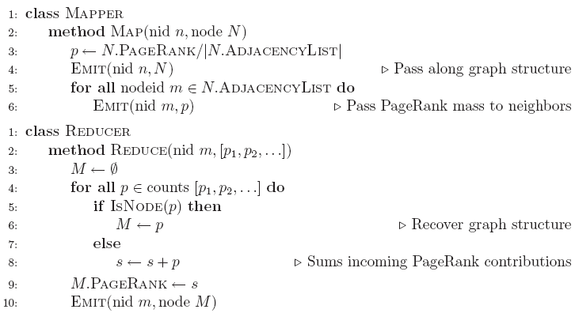
PageRank Pseudo-Code

Slide 47
PageRank vs. BFS
PageRank
BFS
Map
PR/N
d+1
Reduce
sum
min

Slide 48
Complete PageRank
Two additional complexities
What is the proper treatment of dangling nodes?
How do we factor in the random jump factor?
Solution:
Second pass to redistribute “missing PageRank mass” and account for random jumps
p is PageRank value from before, p' is updated PageRank value
N is the number of nodes in the graph
m is the missing PageRank mass
Additional optimization: make it a single pass!

Slide 49
PageRank Convergence
Alternative convergence criteria
Iterate until PageRank values don’t change
Iterate until PageRank rankings don’t change
Fixed number of iterations
Convergence for web graphs?
Not a straightforward question
Watch out for link spam:
Link farms
Spider traps
…

Slide 50
Beyond PageRank
Variations of PageRank
Weighted edges
Personalized PageRank
Variants on graph random walks
Hubs and authorities (HITS)
SALSA

Slide 51
Applications
Static prior for web ranking
Identification of “special nodes” in a network
Link recommendation
Additional feature in any machine learning problem

Slide 52
Other Classes of Graph Algorithms
Subgraph pattern matching
Computing simple graph statistics
Degree vertex distributions
Computing more complex graph statistics
Clustering coefficients
Counting triangles

Slide 53
General Issues for Graph Algorithms
Sparse vs. dense graphs
Graph topologies

Slide 54


Source: http://www.flickr.com/photos/fusedforces/4324320625/

Slide 55
MapReduce Sucks
Java verbosity
Hadoop task startup time
Stragglers
Needless graph shuffling
Checkpointing at each iteration

Slide 56
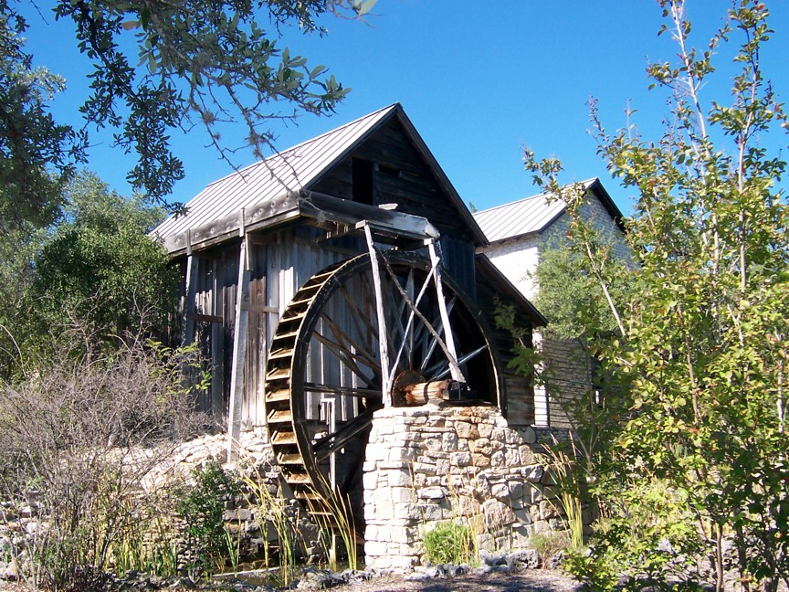
Iterative Algorithms
Source: Wikipedia (Water wheel)

Slide 57
MapReduce sucks at iterative algorithms
Alternative programming models (later)
Easy fixes (now)

Slide 58
In-Mapper Combining
Use combiners
Perform local aggregation on map output
Downside: intermediate data is still materialized
Better: in-mapper combining
Preserve state across multiple map calls, aggregate messages in buffer, emit buffer contents at end
Downside: requires memory management
buffer
setup
map
cleanup
Emit all key-value pairs at once

Slide 59
Better Partitioning
Default: hash partitioning
Randomly assign nodes to partitions
Observation: many graphs exhibit local structure
E.g., communities in social networks
Better partitioning creates more opportunities for local aggregation
Unfortunately, partitioning is hard!
Sometimes, chick-and-egg…
But cheap heuristics sometimes available
For webgraphs: range partition on domain-sorted URLs

Slide 60
Schimmy Design Pattern
Basic implementation contains two dataflows:
Messages (actual computations)
Graph structure (“bookkeeping”)
Schimmy: separate the two dataflows, shuffle only the messages
Basic idea: merge join between graph structure and messages
both relations sorted by join key
both relations consistently partitioned and sorted by join key
S
S₁
T
T₁
S₂
T₂
S₃
T₃

Slide 61
Do the Schimmy!
Schimmy = reduce side parallel merge join between graph structure and messages
Consistent partitioning between input and intermediate data
Mappers emit only messages (actual computation)
Reducers read graph structure directly from HDFS
from HDFS
(graph structure)
intermediate data
(messages)
from HDFS
(graph structure)
intermediate data
(messages)
from HDFS
(graph structure)
intermediate data
(messages)
S₁
T₁
S₂
T₂
S₃
T₃
Reducer
Reducer
Reducer

Slide 62
Experiments
Cluster setup:
10 workers, each 2 cores (3.2 GHz Xeon), 4GB RAM, 367 GB disk
Hadoop 0.20.0 on RHELS 5.3
Dataset:
First English segment of ClueWeb09 collection
50.2m web pages (1.53 TB uncompressed, 247 GB compressed)
Extracted webgraph: 1.4 billion links, 7.0 GB
Dataset arranged in crawl order
Setup:
Measured per-iteration running time (5 iterations)
100 partitions

Slide 63
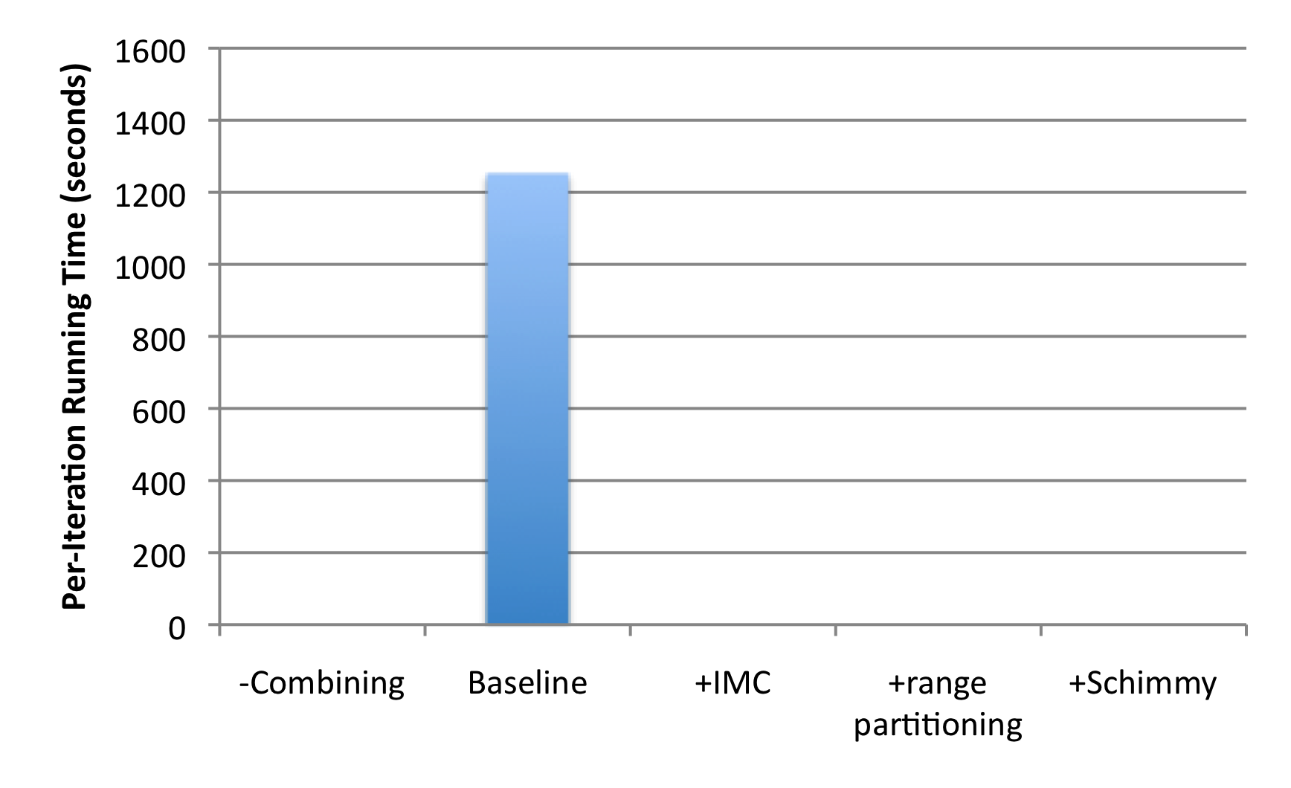
Results
“Best Practices”

Slide 64
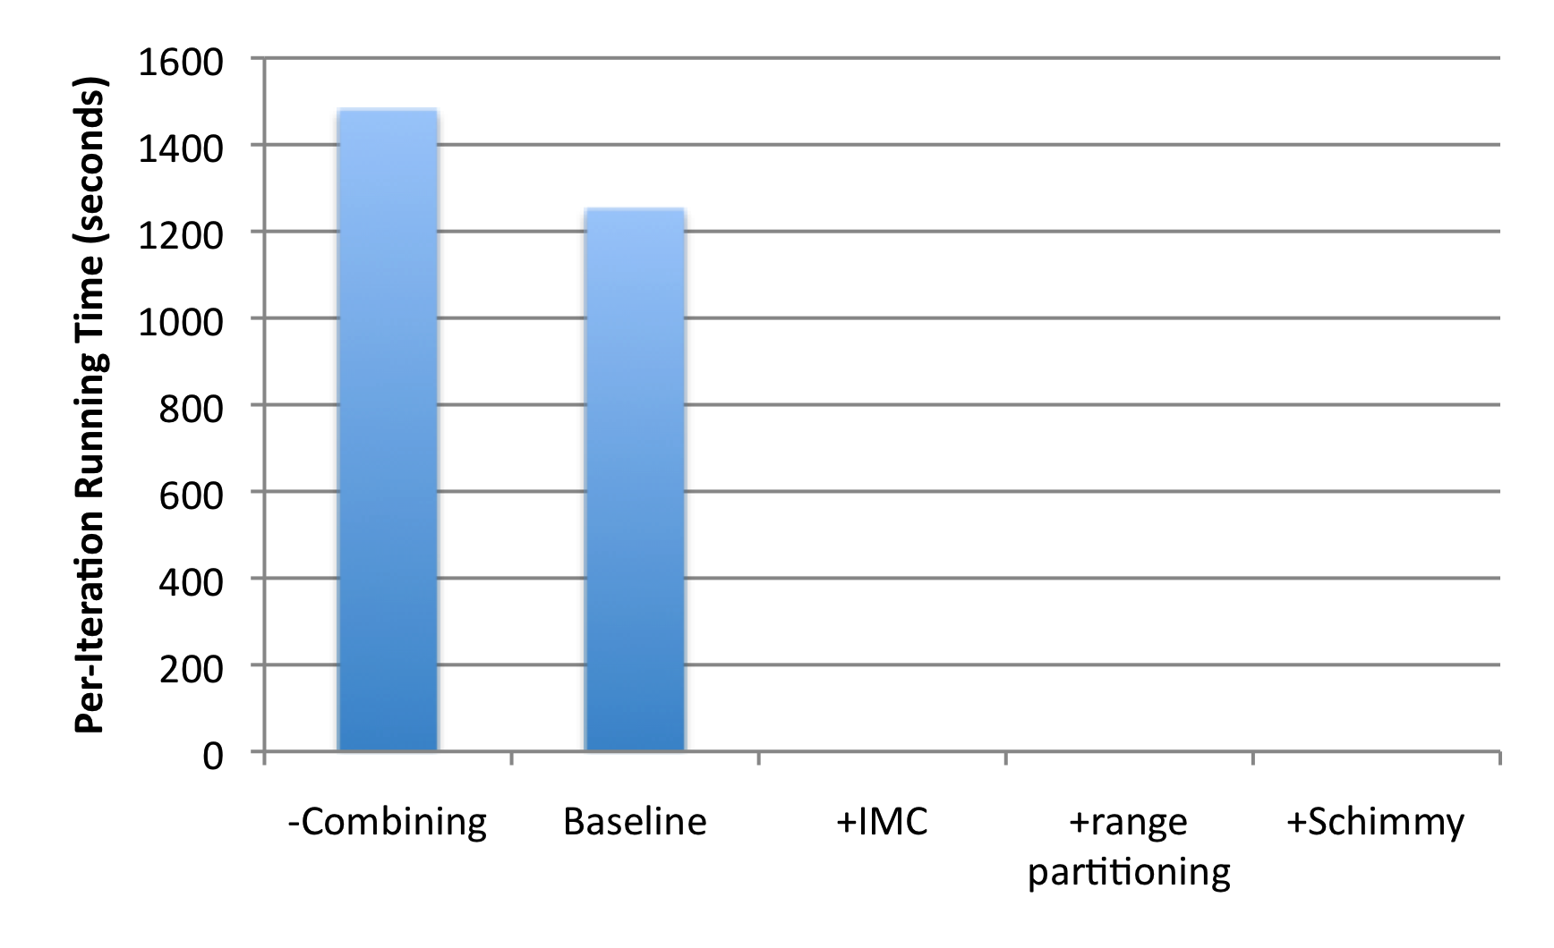
Results
+18%
1.4b
674m

Slide 65
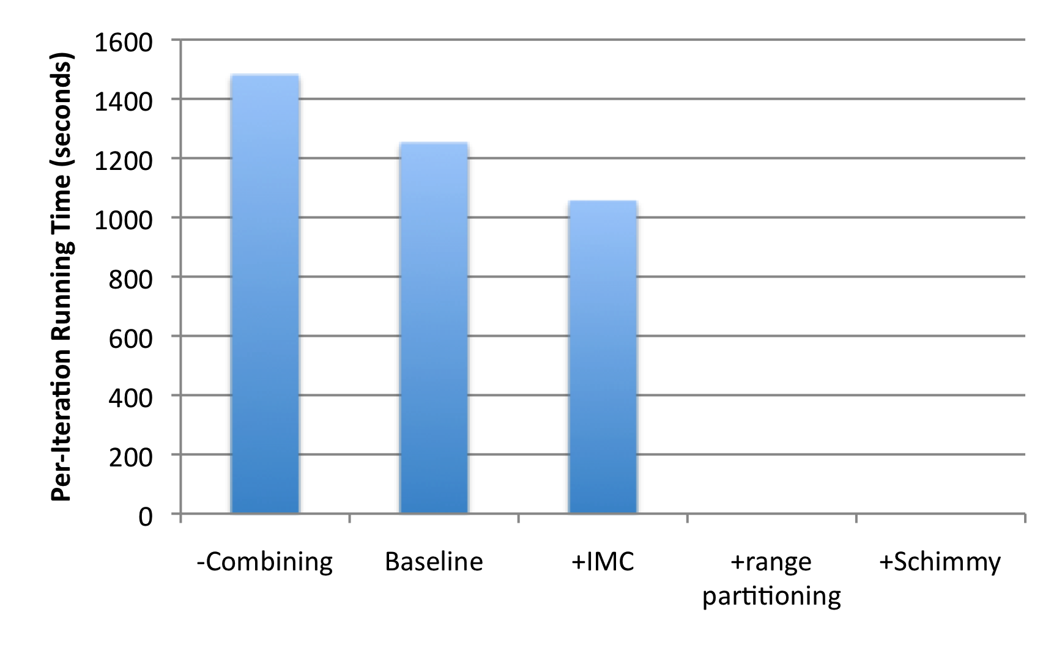
Results
+18%
1.4b
674m
-15%

Slide 66
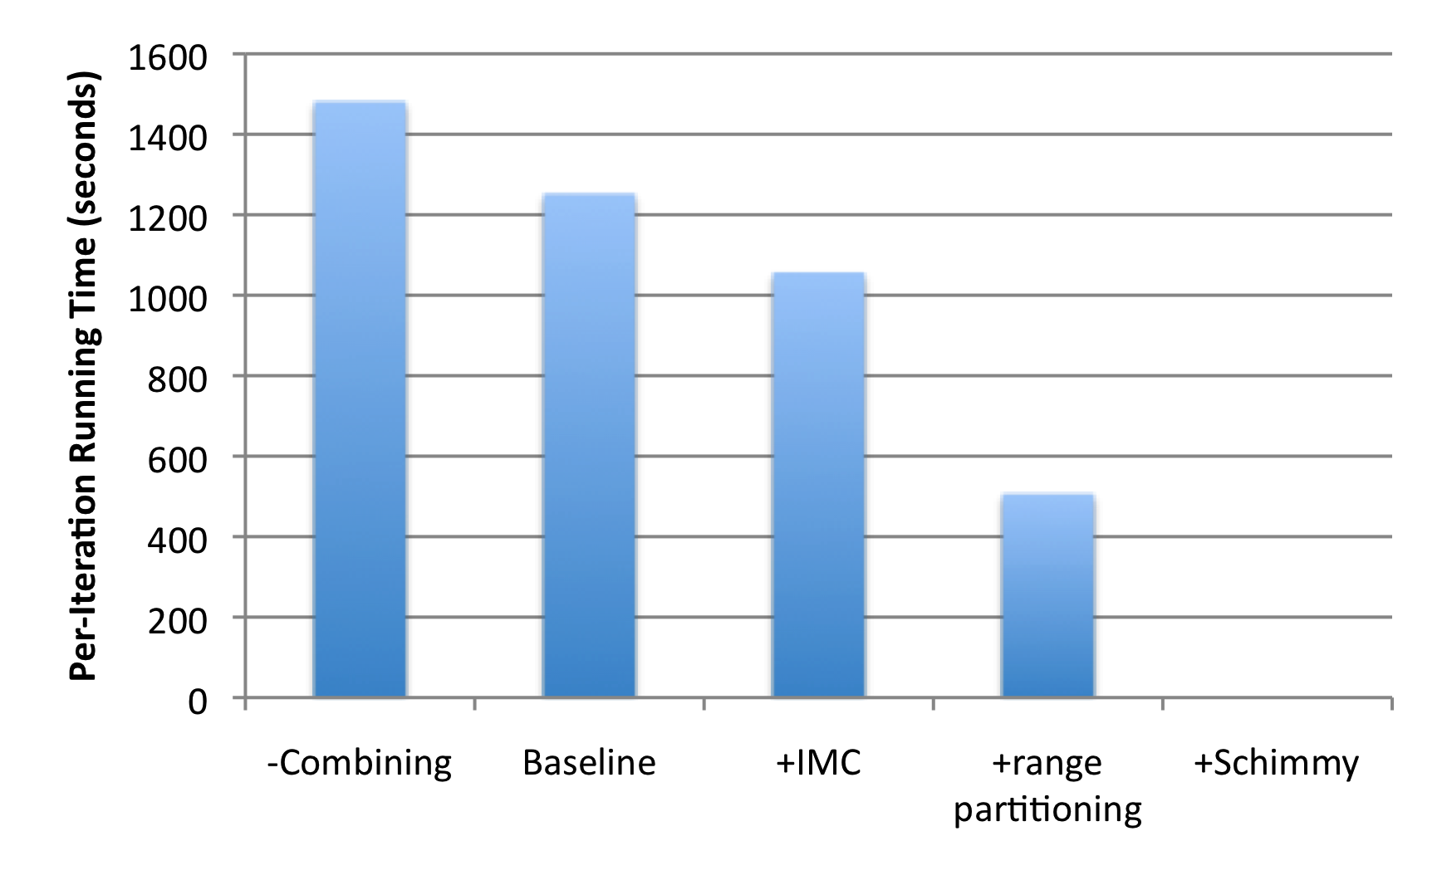
Results
+18%
1.4b
674m
-15%
-60%
86m

Slide 67
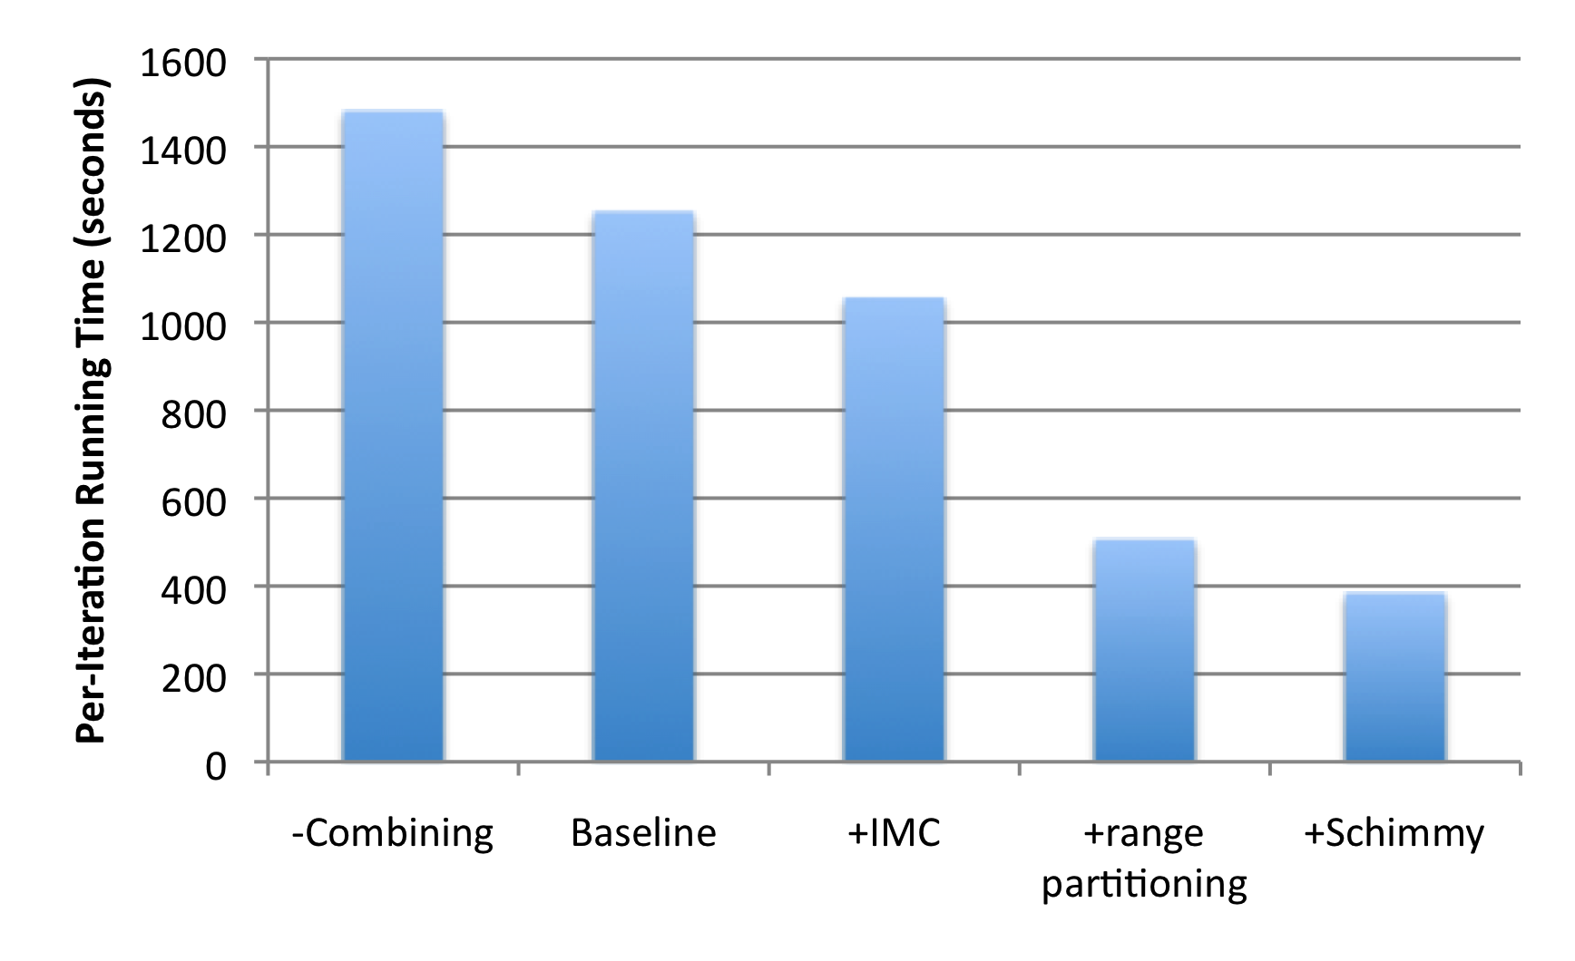
Results
+18%
1.4b
674m
-15%
-60%
86m
-69%

Slide 68
MapReduce sucks at iterative algorithms
Alternative programming models (later)
Easy fixes (now)
Later, the “hammer” argument…

Slide 69
Today’s Agenda
Graph problems and representations
Parallel breadth-first search
PageRank
Beyond PageRank and other graph algorithms
Optimizing graph algorithms

Slide 70

Questions?
Source: Wikipedia (Japanese rock garden)

